Slide 1
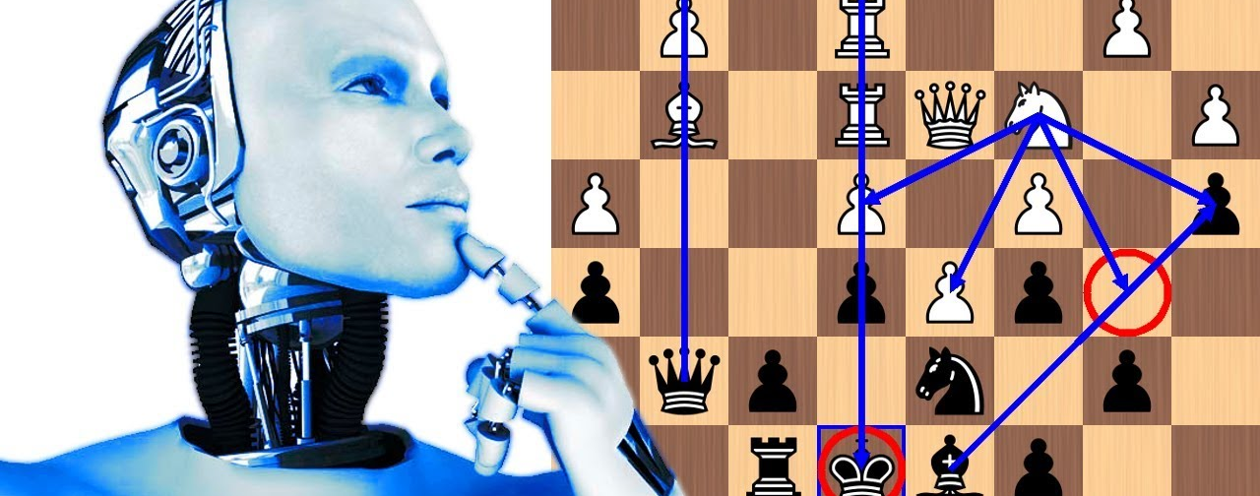
Multi-Threaded Chess AI
Group 18 – Jonathan Cirillo, Jesse Johnson, Lester Miller, Jonathan Velez, and Marco Peric
Notes:
Jon C
Hello, Welcome to our presentation,
We are group 18, and we created a multi threaded chess AI.
Our group members include, Myself – Jonathan Cirillo + rest

Slide 2

Plan
For our experiment we decided to implement our AI using the Alpha-Beta-Pruning Algorithm.
Alpha-Beta-Pruning is an optimization of the Minimax algorithm, which is commonly used to find the best move in a 2-player game.
By itself, the Alpha Beta algorithm increases the processing speed of minimax - but we plan to improve its performance even further by paralleizing it.
Using Java, we successfully implemented three parallelizations of the Alpha Beta pruning algorithm, each using different parallelization methods.
We then compare the performance of these parallelized versions to the sequential version, to determine if there was any improvement, and evaluate which technique was most effective and why.
Notes:
Jon C
Our plan
There exist many ways to implement Chess AIs. Some more famous modern ones use Machine Learning and Neural Networks.
For our experiment we decided to implement our AI using the Alpha-Beta-Pruning Algorithm

Slide 3

Minimax/Alpha-Beta
Minimax & Alpha-Beta Pruning
Minimax search tree: filters best move
Node values: alternating min & max at each depth
Chess application: alternating moves, board states
Guarantees best move at given depth
Alpha-beta pruning
Evaluates root node (current chess position)
Explores all possible moves
Alpha & beta values track best scores
Alpha: initially negative infinity
Beta: initially positive infinity
Updates alpha & beta during search
Prunes subtree when alpha >= beta
Subtree contains non-optimal moves
Maximizing node: updates alpha (max score)
Minimizing node: updates beta (min score)
Notes:
Jonathan V

Slide 4
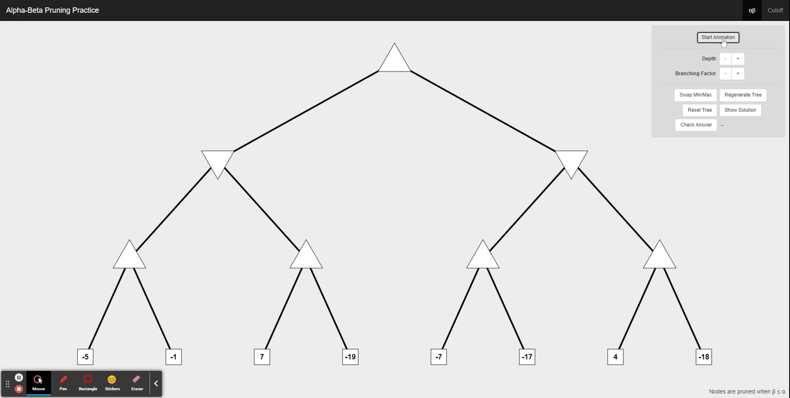
Notes:
Jonathan V

Slide 5
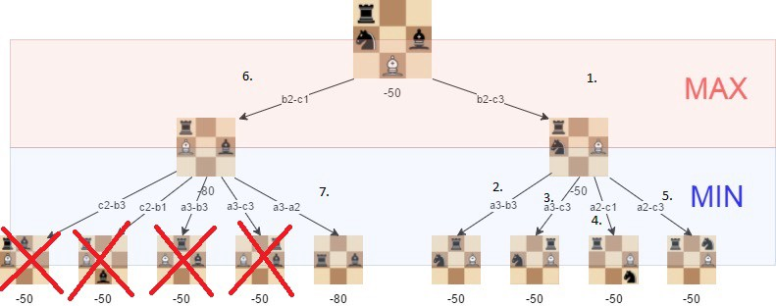
Alpha-Beta for Chess
Assess each potential move from the current board position
Identifies the optimal move for the current player.
The algorithm maintains alpha and beta values, representing the best scores discovered so far for maximizing and minimizing each play.
As the algorithm evaluates each child node, it updates the alpha and beta values based on the scores found up to that point
Prunes the current subtree when alpha is greater than or equal to beta.
Notes:
Jonathan V

Slide 6
Existing Chess Game
Built onto open-source Java chess game & engine that used a sequential Alpha-Beta for its AI
Features of existing code :
Board evaluator that assesses positions based on a given criteria and point system
Move Ordering for sorting moves by threat and attack status. (best first search)
Takes in a chess position and returns best move for current player
Iterates over legal moves and traverses game tree
Utilizes Max and min helper methods to implement Alpha-Beta pruning
Calculates execution time for each move
Notes:
Jon C
So to test our Parellized Alpha Beta for chess, we needed to be able to test it in the context of an actual chess game.
At first we started building our own, but it was very time consuming, and the focus of the project was the parellized AI and not the game itself. So we opted to find an open source, finished-version, that we could use as a medium for testing.
The code we used already implemented a sequential alpha beta. There were core features of this code, separate from the alpha beta algortihm, that we kept constant in our code as well, to function as controlled variables.
Best first search – Sorts moves in such a way that – moves that are more likely to produce a positive outcome are explored first, to increase pruning potential
We are most concerned with the move time result for our experiment. In the next slide we will discuss how this code implemented alpha beta.

Slide 7
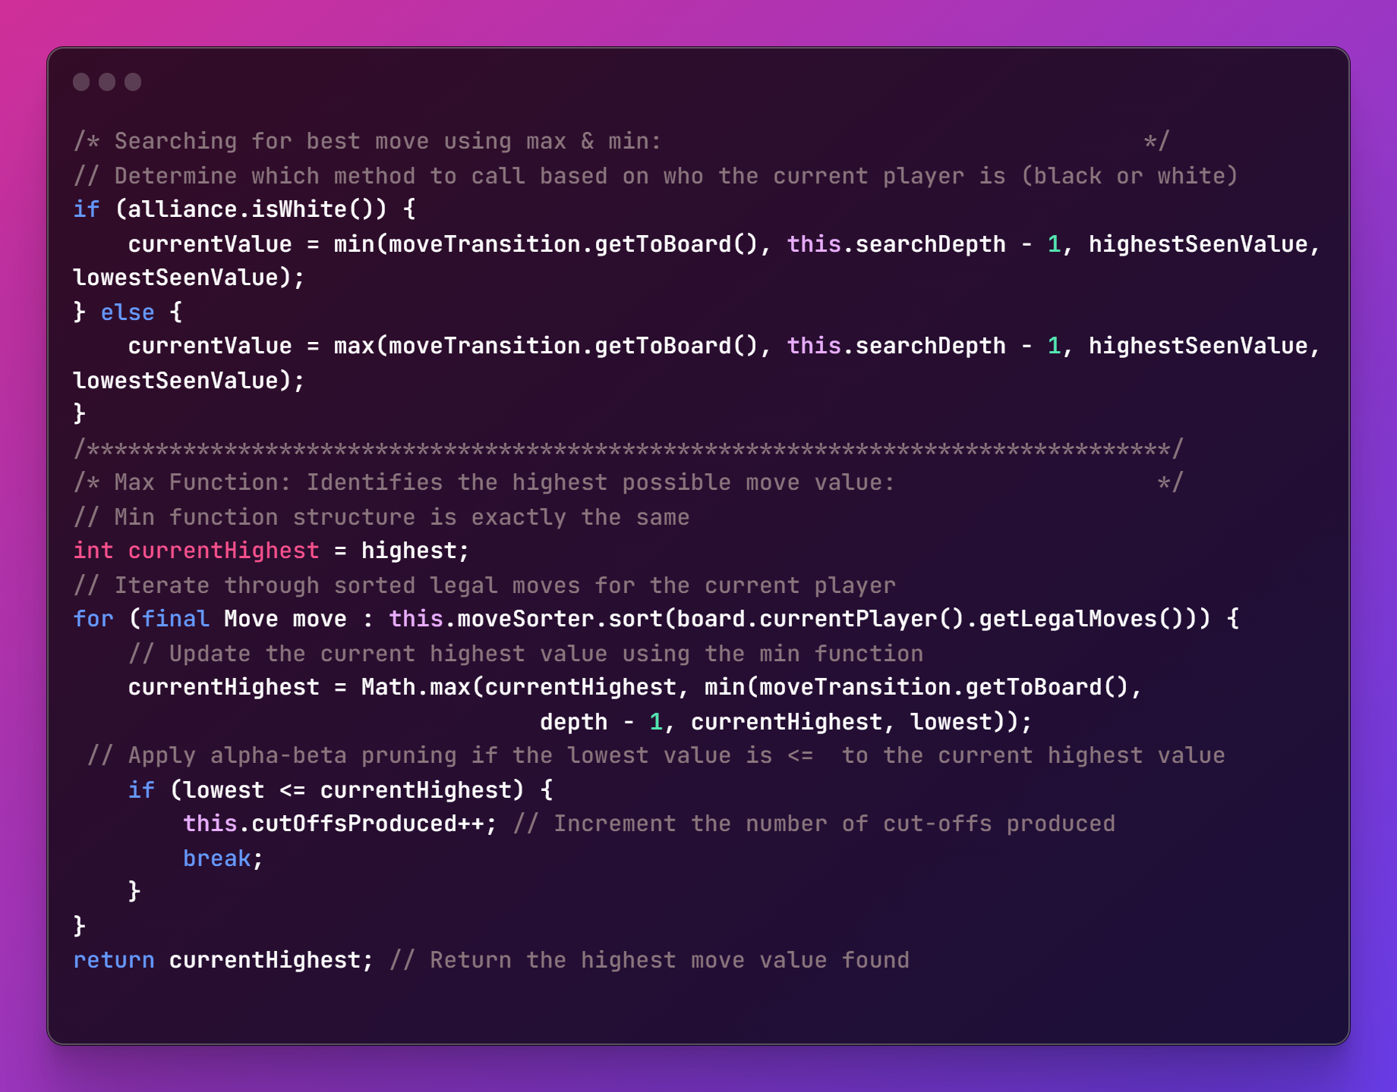
Sequential Implementation
First determine first whether we are the minimizing or maximizing player (black or white)
The corresponding helper method is called
**********************************************
Min/Max Function:
Initialize current lowest/highest value
Sort and iterate through legal moves
Update the current highest value using the min/max function
Implements alpha-beta pruning
Returns lowest/highest value move found
Notes:
Jesse

Slide 8
Parallel Implementation Overview & Techniques
Atomic Variables
Enable safe concurrent updates
Transposition Table & Zobrist Hashing
Implemented with a concurrent HashMap for thread-safe access
Zobrist Hashing for fast and unique position identification
Reduces redundant computations, improving performance
Parallelization methods
Executor Service
ForkJoinTask
Parallel Streams
Notes:
Jesse

Slide 9
Transposition Table & Zobrist Hashing
Zobrist hashing is used to generate unique hash keys for each game state, which helps in efficient storage and retrieval of positions in the transposition table.
The transposition table acts as a cache for storing previously computed results, allowing for quicker lookups and eliminating redundant calculations.
Concurrent HashMap used to implement the transposition table to allow for concurrent read and write operations.
Multiple threads can access the transposition table simultaneously without synchronization overhead.
This concurrency control leads to a reduction in computational time and an enhancement in overall performance.
Notes:
LESTER
"All three of our parallelization techniques make use of Zobrist hashing and a transposition table. Zobrist hashing is an algorithm that is used to generate a unique hash key for each game state that is evaluated. This is done by randomly generating a bitstring for all possible piece and position combinations. When a game state is evaluated, each piece & position is then XORed with the randomized bitstring to create the unique hash. This hash key is then stored in a transposition table which acts as a cache for storing previously computed results, allowing for quicker lookups and eliminates redundant calculations. We used a concurrent HashMap to implement our transposition table which allows multiple threads to access it simultaneously without synchronization overhead, which is possible because concurrent HashMaps allow for concurrent read and write operations without locking the entire data structure. This concurrency control leads to a reduction in computational time and an enhancement in overall performance."

Slide 10
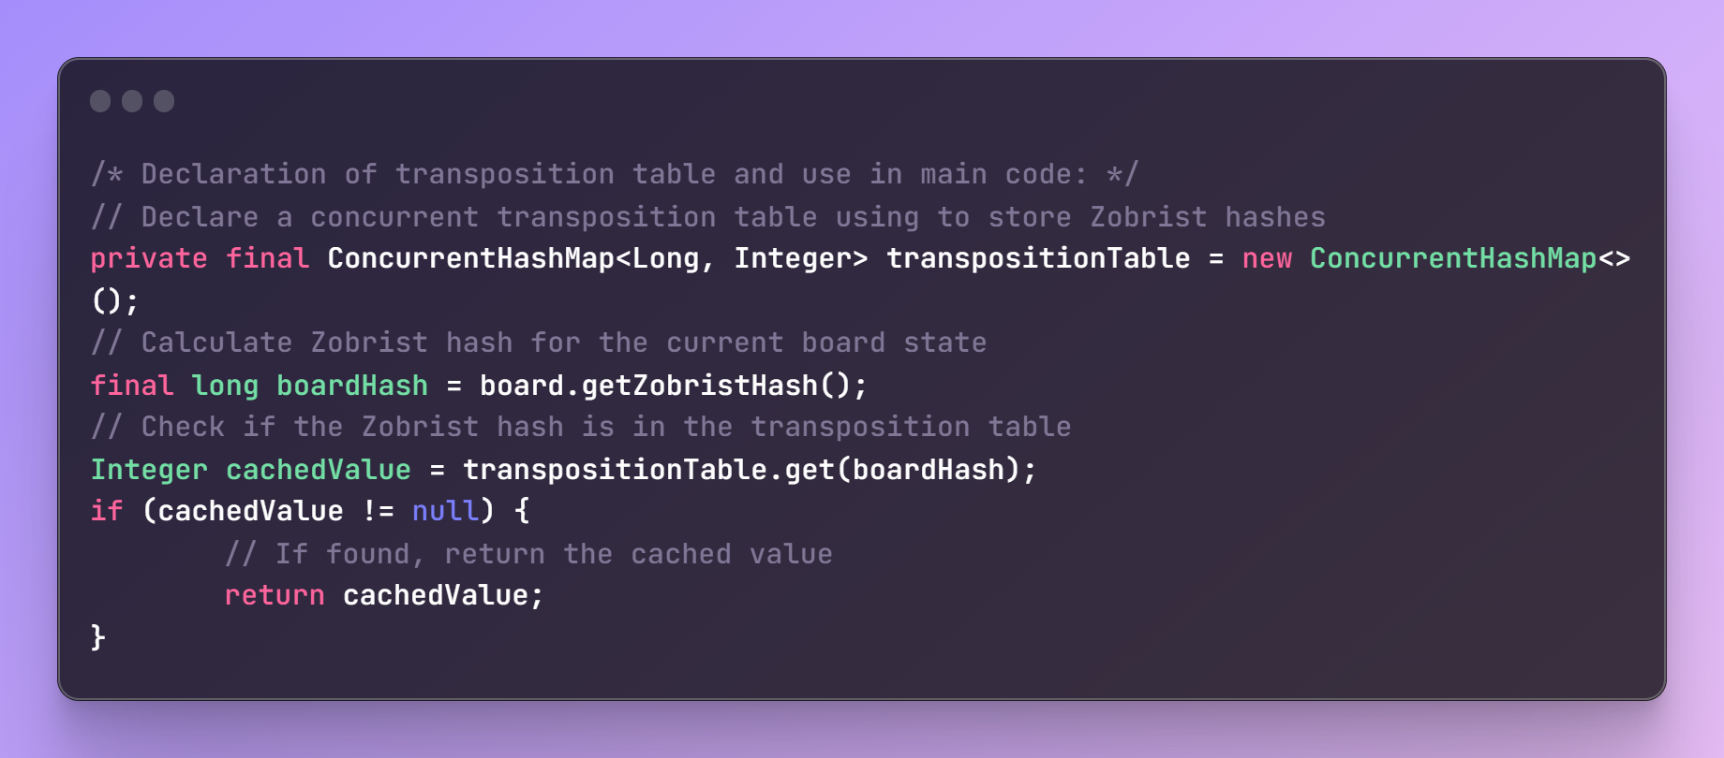
Using the Transpositional Table in the code
Notes:
Lester
"Here is quick look at the code used in our transpositional table implementation. Before any move calculations are made, we obtain a Zobrist hash for the current game state and compare it to the transposition table. If this game state has been evaluated before, we return the cached value and avoid unnecessary calculations."

Slide 11
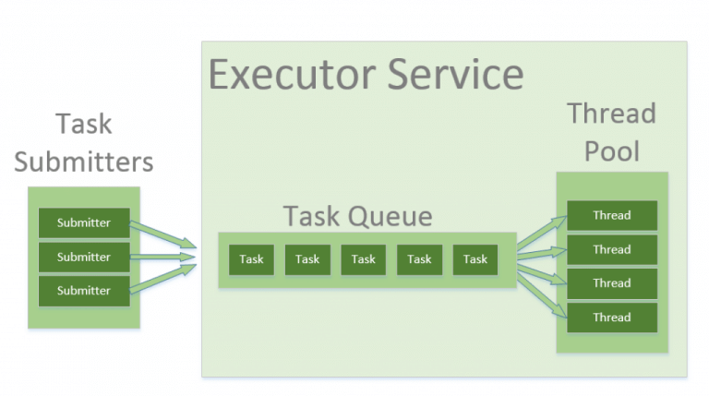
Notes:
Lester
Task Submission:
Tasks are submitted to the ExecutorService as Runnable or Callable objects.
ExecutorService handles synchronization, ensuring thread-safe execution.
Developers can focus on implementing task logic without worrying about thread management.
Task Queue:
When tasks are submitted, they are stored in a queue.
The queue can have a limited or unlimited capacity, depending on configuration.
If the queue is full, the ExecutorService may create additional threads or block further task submission
Thread Pool:
ExecutorService manages a pool of worker threads.
The pool's size can be fixed or dynamically adjusted based on demand.
Thread creation, reuse, and termination are all handled by the ExecutorService.
Worker Threads:
Worker threads fetch tasks from the queue and execute them concurrently
Once a task is completed, the worker thread is returned to the pool for reuse.
“The first method of Alpha-Beta pruning parallelization was implemented using Java’s Executor Service. Executor service handles synchronization and ensures thread-safe execution behind the scenes, allowing the developer to focus on implementing task logic without worrying about the details of thread management.
Tasks are submitted to the Executor Service as runnable or callable objects, and these tasks are then stored in a queue which can be configured to have a limited or unlimited capacity. Should the queue become full, additional threads may be created or blocked by the executor service depending on the configuration that is being used. The tasks in the queue are distributed amongst a pool of worker threads which execute them concurrently, and once a thread has completed a task it is returned to the thread pool and awaits its next task. Thread creation, reuse, and termination are all handled by the executor service, and the size of the thread pool can be fixed or dynamically adjusted."

Slide 12
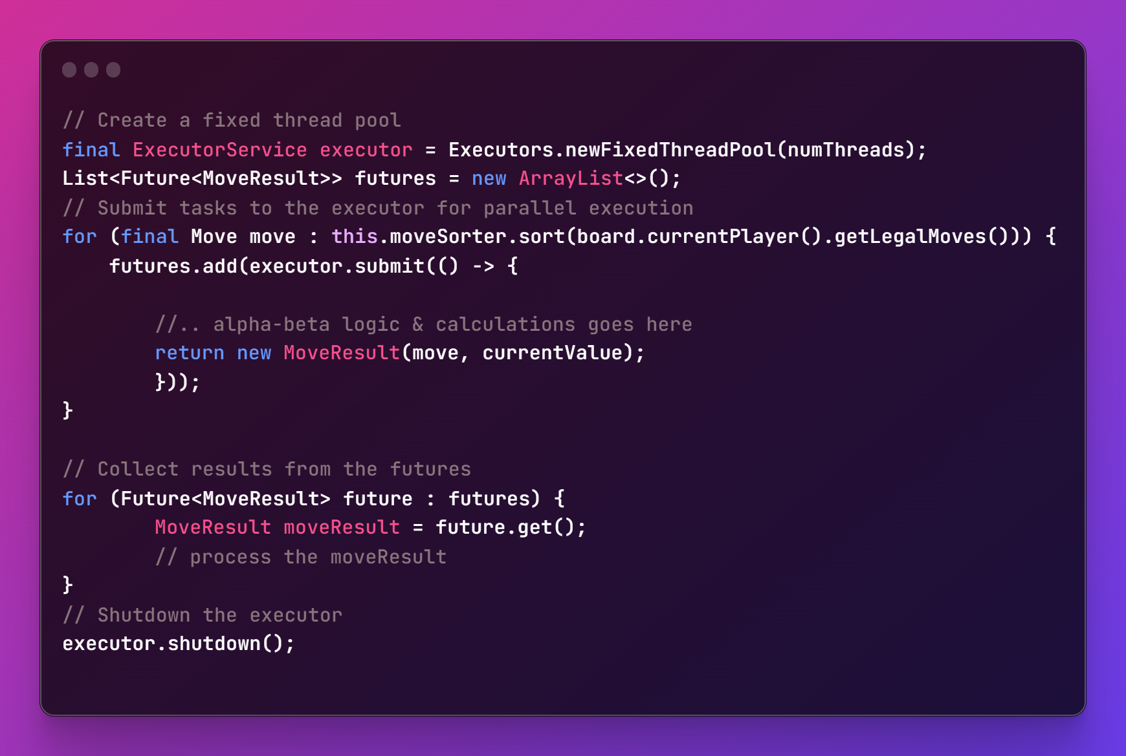
Executor Service Implementation
Create a fixed thread pool with a specified number of threads.
For each legal move, submit a task to the executor for parallel execution.
Collect results from the futures by calling future.get() and process them accordingly.
Shut down the executor after all tasks are done.
Notes:
Lester
The Future interface provides a special blocking method get(), which returns an actual result of the Callable task's execution or null in the case of a Runnable task:
“By default our project determines the number of cores available and then has the executor service use the maximum number of possible threads. Every possible legal move is submitted to as a task to the executor. We make use of the Future interface which represents a future result of a computation and is especially useful for computationally intensive processes. We use the method future.get() to return the results of each move calculation task after it’s completed and store it in an array list. The array list is then processed for the best move.”

Slide 13
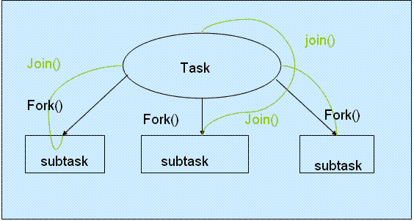
ForkJoinTask
Notes:
Jon C
The second parellization technique we used was ForkJoinTasks
This a parallelization method that works best for tasks that can be divided into smaller subtasks, recursively (Think Divde & Conquer)
The ForkJoinTasks are apart of the Fork /Join framework, that Implements work stealing - meaning threads that have completed their assigned tasks can steal tasks from other threads that are still busy.
Recursive Task Splitting: (depicted in the diagram)
This is the process of breaking down the main task into subtasks.
Usually Implemented in the compute() method of a ForkJoinTask subclass.( in our code we use, The 'RecursiveTask' subclass)
Subtasks are created using the fork() method, which executes them in a ForkJoinPool.
Worker threads in a ForkJoinPool execute subtasks concurrently.
All threads in the pool will attempt to find and execute other tasks submitted to the pool OR tasks created by other active tasks (which is where works stealing comes in)
Task Execution and Merging:
Once subtasks are completed, their results are combined (merged) to form the overall solution.
Merging is achieved using the join() method, which waits for a subtask's completion and retrieves its result.

Slide 14
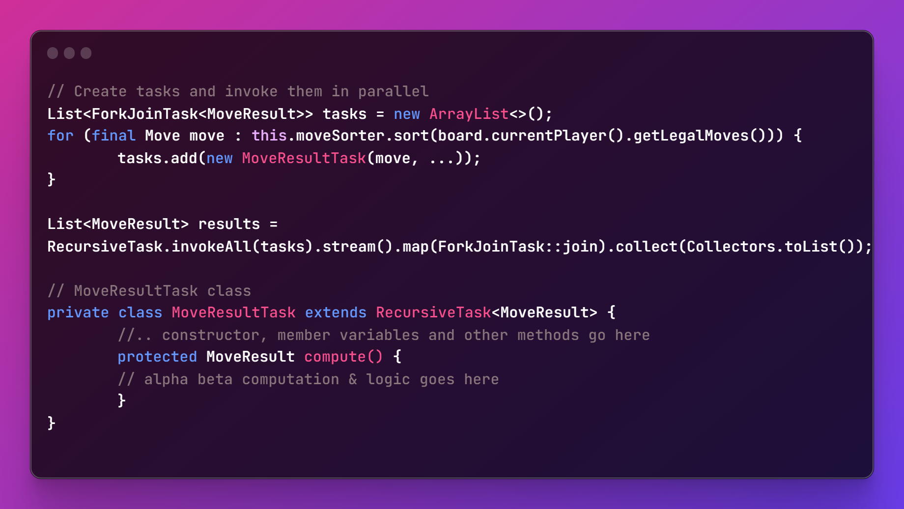
ForkJoinTask Implementation
We create an ArrayList to store tasks for each ordered move.
A task is then instantiated for each move, in a loop that iteratives over the list of ordered moves.
Then, we submit tasks to the ForkJoinPool using the 'invokeAll()' method
Once all the threads are finished running, we collect the results by joining each task and processing them as needed.
Notes:
Jon C

Slide 15
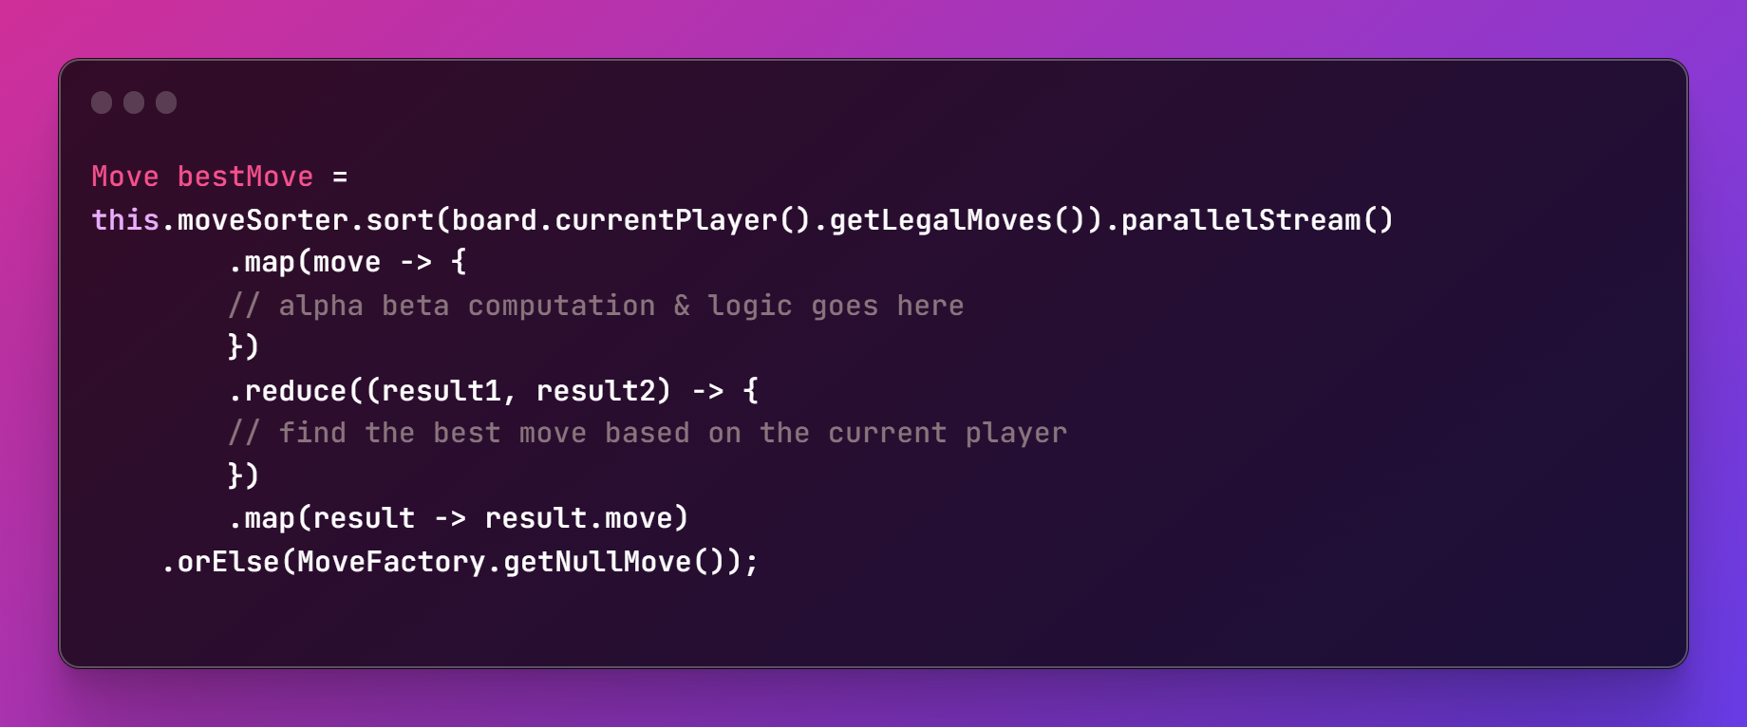
Parallel Streams Implementation
In Java 8, the Streams API was released, which enabled developers to use functional programming techniques.
Parallel Streams uses the ForkJoin framework internally to execute tasks concurrently, but the implementation differs
The parallelStream() method is used to convert the sequential 'stream' of moves into a parallel stream
The .map function is used to performs the alpha beta calculations for each move
Then the .reduce function is used to merge the results and calculate the best move for the current player
Lastly, the best move is then extracted once again using the .map function.
A null move is retunred if there's no result, using the .orElse function
Notes:
Jon C
In Java 8, the Streams API was released, which enabled developers to use functional programming techniques.
For this implementation we use the .parallelStream() method (which uses the fork join framework in the background, to execute tasks concurrently
Stream Conversion (Sequential to Parallel):
A sequential stream can be converted to a parallel stream using the parallel() method.
Parallel streams divide tasks into smaller chunks to process tasks concurrently
Task Execution:
Parallel streams also uses the Fork Join framework in the background to execute tasks concurrently,
Task Combination:
Once subtasks are completed, their results are combined into a single result.
This process is called "joining," where partial results are merged, typically using reduction or accumulation functions.
Result Collection:
The final result of the parallel stream operation is collected and returned.
Developers can use terminal operations like collect(), reduce(), or forEach() to obtain the result.

Slide 16
Testing Strategy
To test each approach, we had them play themselves up to a set number of moves and depth.
For this experiment, the depth was kept constant.
Number of cores, and parallel-implementation are our independent variables
We measured the move time calculations for each move of each game
For each of the 4 implementations, we had the AI play itself 5 times, so 20 games altogether.
We chose to only consider the first 50 moves (25 for each side) as they are the most computationally intensive (most possibilities) and near the end times speed-up & normalize
Each 5 team members repeated these steps on their own hardware, to get a total of 100 games
Tested on 2,4, and 8 core machines.
Compared the overall move-time averages for each game.
Notes:
Marco

Slide 17
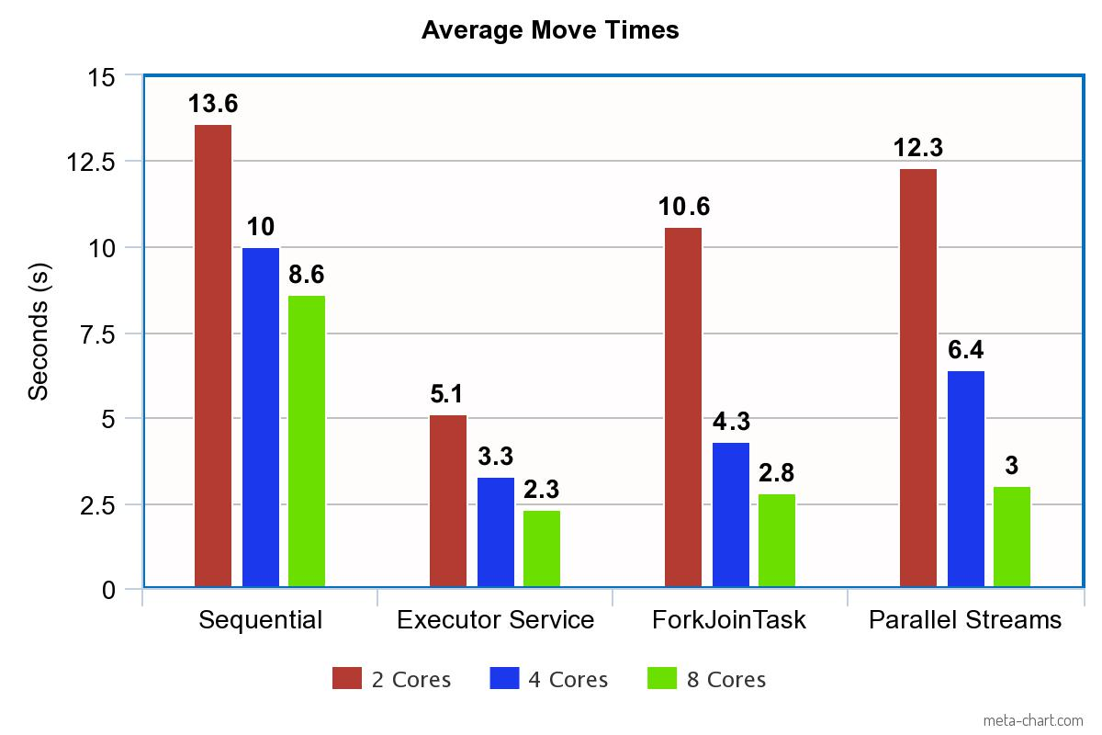
Results
Notes:
Marco

Slide 18
Evaluation
These findings indicate that ExecutorService offers the best performance, followed by ForkJoinTasks & Parallel Streams.
ExecutorService advantages:
Maintains constant thread pool
ThreadPoolExecutor prevents repeated thread creation/destruction (no idle threads)
Aligns well with iterative control flow of Alpha-Beta algorithm
ForkJoinTasks limitations:
If tasks being executed have varying execution times the work-stealing algorithm may not effectively balance the workload.
Some moves are much more computationally expensive than others, and threads may steal in a suboptimal way, causing some threads to perform much more work than others. This imbalance can lead to decreased performance.
Work stealing can lead to cache misses which occur when a worker accesses a subtask that is not in its local cache, causing delays and traffic.
Moving work from one thread to another creates overhead that may be computationally expensive
Parallel Streams limitations:
Functional programming relies heavily on function calls and may produce more intermediate objects than other approaches.
This can lead to increased overhead due to function call management and garbage collection, potentially affecting performance.
Overall, all implementations performed better than sequential.
Notes:
Marco

Slide 19
Limitations/Challenges
Testing environment
Not perfectly controlled
Other programs running on the computer may affect results
Played 5 games per implementation in an attempt to reduce error
Inherent randomness in games
Varying computation times per position due to changing number of possibilities
Focused on initial 50 moves, which are usually the most computationally demanding, to minimize the impact of randomness.
Sequential vs. parallel exploration
Sequential: consistent node exploration -> given the same position, will choose same move every time
Parallel: Multiple threads evaluate nodes simultaneously, nodes may be explored in a different order each time -> causing different pruning decisions and alternative moves being selected.
Experiment depth
Kept constant due to exponential growth of chess move trees
Increasing depth made data collection impractical
Notes:
Jesse

Slide 20

Future Research Ideas
For future research, it would be worthwhile to evaluate these parallelism techniques on a variety of other algorithms beyond the Alpha-Beta to gain a broader understanding of their effectiveness and applicability across various problem areas.
This could offer important insights into each method's advantages and drawbacks, helping someone pick the most appropriate parallelism technique for what their task requires.
Another avenue to explore would be having each implementation play against each other, to gain an idea of where they rank skill wise, and determine if multi-threading leads to a decrease in skill.
Notes:
Jonathan V

Slide 21

Conclusion
The parallel implementations proved to improve the performance of the Sequential Alpha-Beta Pruning Algorithm for Chess
Due to the large variation in chess games, a larger scale study could provide more insightful results.
We plan to upload a final version of our AI to the Lichess website for anyone to play against.
Notes:
Jon C

Slide 22
Links
Our GitHub repo: https://github.com/cirillojon/ChessAI
Open-Source chess game used: https://github.com/amir650/BlackWidow-Chess/tree/master/src/com/chess
Link to Research Paper:
Link to Video:

Slide 23
References
https://blogs.oracle.com/javamagazine/post/java-parallel-streams-performance-benchmark
https://raphsilva.github.io/utilities/minimax_simulator/
https://www.freecodecamp.org/news/simple-chess-ai-step-by-step-1d55a9266977/
https://www.java67.com/2018/10/java-8-stream-and-functional-programming-interview-questions-answers.html
https://docs.oracle.com/javase/tutorial/essential/concurrency/forkjoin.html
https://www.baeldung.com/java-when-to-use-parallel-stream
https://medium.com/javarevisited/java-8-parallel-stream-java2blog-e1254e593763

